Slide 1
Noise Regulations for Airports
Aircraft Noise Stages and Use Restrictions
April 26, 2017

Slide 2
Relevant Statutes
Aircraft Noise Abatement Act
49 U.S.C. 44715 – 1968
FAA may prescribe standards for measurement and regulation of aircraft noise
Aviation Safety and Noise Abatement Act
ASNA – 49 U.S.C. 47501 et seq. – 1978
FAA may regulate “air noise compatibility planning”
Airport Noise and Capacity Act
ANCA – 49 U.S.C. 47521 et seq. – 1990
Phase-out of Stage 2 aircraft > 75,000 pounds
FAA may fund airport projects in an approved noise compatibility program
FAA may establish standards for measuring noise impacts
Limits on any restrictions of Stage 2 and Stage 3 aircraft
FAA Modernization and Reform Act
P.L. 112-95 – 2012
Ban on almost all Stage 2 aircraft after December 31, 2015
Requires FAA to establish a single system of measuring noise

Slide 3
Relevant Statutes
Aircraft Type and Airworthiness Certification
Part 36 Noise Standards – 1969, as amended
Provides process for determining aircraft noise levels
Operating Noise Limits
Part 91, Subpart I – 1976, as amended
Defines aircraft noise “stages”
Airport Noise Compatibility Planning
Part 150 – 1984, as amended
FAA response to meet requirements of ASNA
Requires phase out of Stage 2 aircraft
Voluntary program for airports/communities to determine and address incompatible land uses
Notice and Approval of Noise and Access Restrictions
Part 161 – 1991
Federal program to for reviewing noise and access restrictions on use of Stage 2 and 3 aircraft
Notes:
FAA promulgated Part 150
Selected the A-weighted sound level (dB)
Selected the Day-Night-Average Sound Level (DNL)
Defined a voluntary noise compatibility planning process
Identifies variety of land use categories considered to be compatible with aircraft operations for a range of noise levels
Suggests 65 dB DNL threshold of compatibility for residential uses
See generally: Table at 14 CFR Part 150, Appendix A.

Slide 4
Part 36: Noise Certification
The prime purpose of noise certification is to ensure that the latest available noise reduction technology is incorporated into aircraft design demonstrated by procedures which are relevant to day to day operations, to ensure that noise reduction offered by technology is reflected in reductions around airports.
Source: The seventh meeting of the Committee on Aviation Environment Protection (CAEP/7), 2007

Slide 5
Part 36: Noise Stages
Most relevant for civil subsonic jets and large transport-category (over 12,500lbs.)
“Stage 1” aircraft have never been shown to meet any noise standards
  Either never tested, or tested and failed
“Stage 2” aircraft meet original (1969) limits
“Stage 3” meet more stringent (1977) limits
“Stage 4” meet newest (2006) limits
“Stage 5”
  International Civil Aviation Organization (ICAO) adopted Chapter 14 for newly-designed aircraft entering service from:
    2017 for high-weight aircraft
    2020 for lower weight aircraft

Slide 6
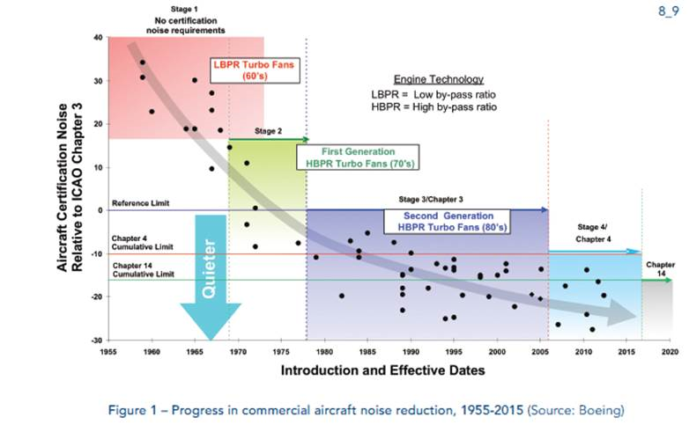
Part 36: Noise Stages

Slide 7
Part 161:
Airport Noise and Access Restrictions
Establishes federal program for reviewing noise and access restrictions on use of Stage 2 and 3 aircraft
  Stage 2 restrictions are moot as of January 1, 2016
Comprehensive analysis required, e.g.:
  Evidence of noise problem
  Impacts analysis
  Benefit-cost analysis
Encourages voluntary agreements

Slide 8
Part 161:
Airport Noise and Access Restrictions
Statutory conditions for approval of an access restriction
1. Reasonable, nonarbitrary and nondiscriminatory
3. Maintains safe and efficient use of navigable airspace
4. No conflict with existing Federal law
5. Adequate opportunity for public comment
6. No undue burden on national aviation system
2. No undue burden on interstate or foreign commerce

Slide 9
Part 161:
Airport Noise and Access Restrictions
Many potential roadblocks
  No guidance for benefit/cost analysis
  Aviation interests - a key data source, unlikely to assist
  FAA has made its opposition clear
Study of last resort - perhaps a dozen airports have pursued
  Some abandoned, some disapproved by FAA, some resulted in voluntary agreements
  Two new restrictions
    Naples Stage 2 ban and Van Nuys Stage 2 phase out

Slide 10
SAN Noise and Access Restrictions
San Diego International Airport currently has the following noise and access restrictions in place as implemented by the Airport Use Regulations:
  Loud aircraft ban
  Nighttime departure curfew
  Restrict published departure times
  Engine tests and run-ups
  Airport Use Regulations enforcement
Airport Use Regulations were put in place prior to the Airport Noise and Capacity Act (ANCA), which provided a grandfathering for existing noise and access restrictions to remain in place
Part 161 is required to amend the Airport Use Regulations unless the change results in less restrictive measures
Notes:
Loud aircraft ban
Prohibit aircraft generating more than 104 EPNdB at the FAR Part 36 takeoff measuring point from SAN.
Nighttime departure curfew
Prohibit departures at SAN by all non-Stage 3 aircraft except for emergency and approved mercy flights between 2200 and 0700 Hours. Continue to prohibit departures by all other aircraft except for emergency and approved mercy flights between 2330 and 0630 hours.
Restrict published departure times
Prohibit any scheduled air carrier from publishing or establishing gate departure times at SAN for Stage 3 aircraft after 2315 hours and before 0615.
Engine tests and run-ups
Prohibit above-idle static engine tests or engine run-ups at SAN between 2330 and 0630 hours.
Airport Use Regulations enforcement
The Authority will enforce administrative penalties to deter violations of Airport Use Regulations.
During the update of the SAN Noise Compatibility Program in 2010, the Authority was careful to not ask the FAA for approval of the existing Airport Use Regulations as part of the recommended NCP measures
Enabled the Authority to continue enforcement of the Airport Use Regulations as part of their Noise Compatibility Program at SAN

Slide 11
Questions
Noise Regulations for Airports

