Slide 1
Airport Noise Advisory Committee
February 15, 2017

Slide 2
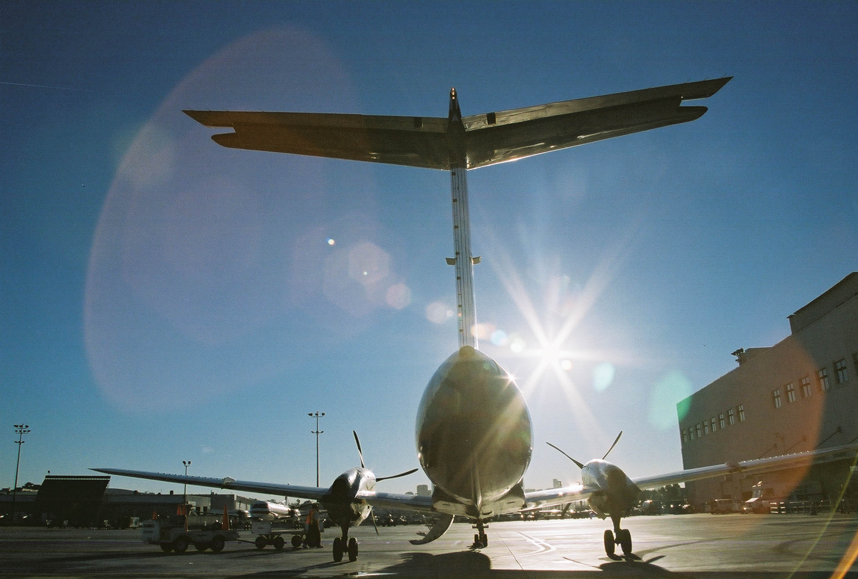
Agenda
Welcome and Introductions
Presentation Items
  Quieter Home Program Update
  Curfew Violation Review Panel
  Missed Approach
  Early Turn Statistics
  Metroplex Update
  Noise Complaint Statistics
Public Comment
Approval of December 21, 2016 Minutes
Information Items
  Subcommittee Update
  Airport Authority Update
New Business
Next Meeting: April 19, 2017
Adjourn
Notes:
Next meeting?

Slide 3
Quieter Home Program Update
PROGRAM STATISTICS
Applicants / Homes on the Wait List | 679/1,449
Homes Completed in December and January 2017 | 0
Estimated Homes to Complete in CY 2017 | ?
Total Completed Homes (through January 31, 2017) | 3,453
Updates
Revising project design packages and contract documents for comprehensive FAA review:
  Non-historic, multi-family, ventilation only
  Historic, single-family, HVAC
  Historic, multi-family, ventilation only

Slide 4
Curfew Violation Review Panel Stats
Year | Total Curfew Violations | Fines Assessed
2013 | 60 | $ 166,000
2014 | 47 | $ 178,000
2015 | 55 | $ 152,165
2016 | 84 | $ 564,000
2017 | 8* | potentially $104,000*
*Through January 31, 2017

Slide 5
Curfew Violation Review
Panel Review Outcome for Dec. & Jan.
Operator | Number of Violations Penalized | Amount Fined on February 1
Alaska Airlines | 1 | $2,000
Allegiant Airlines | 1 | $6,000
Delta Air Lines | 1 | $20,000
Frontier Airlines | 5 | $58,000
jetBlue Airways | 4 | $70,000
Southwest Airlines | 2 | $20,000
Sun Country Airlines | 2 | $8,000
Virgin America | 1 | $2,000
No penalty due to local weather conditions:
December 14, 2016 = JBU 530 (1)
December 21, 2016 = AAL 1042, AAL 785, AAL 563, AAL 2660, FFT 1746, JBU 20, JBU 530, UAL 586 (8)
December 30, 2016 = AAL 563, AAL 2660, DAL 2339 (3)
No penalty due to local maintenance:
December 15, 2016 = AAL 1162
December 22, 2016 = AAL 563P
To be reviewed on April 5 CVRP meeting:
December 22, 2016 = SWA 2091, SWA 6211
January 8, 2017 = JBU 20
January 12, 2017 = FFT 1746, GTI 105
January 30, 2017 = DAL 1192

Slide 6
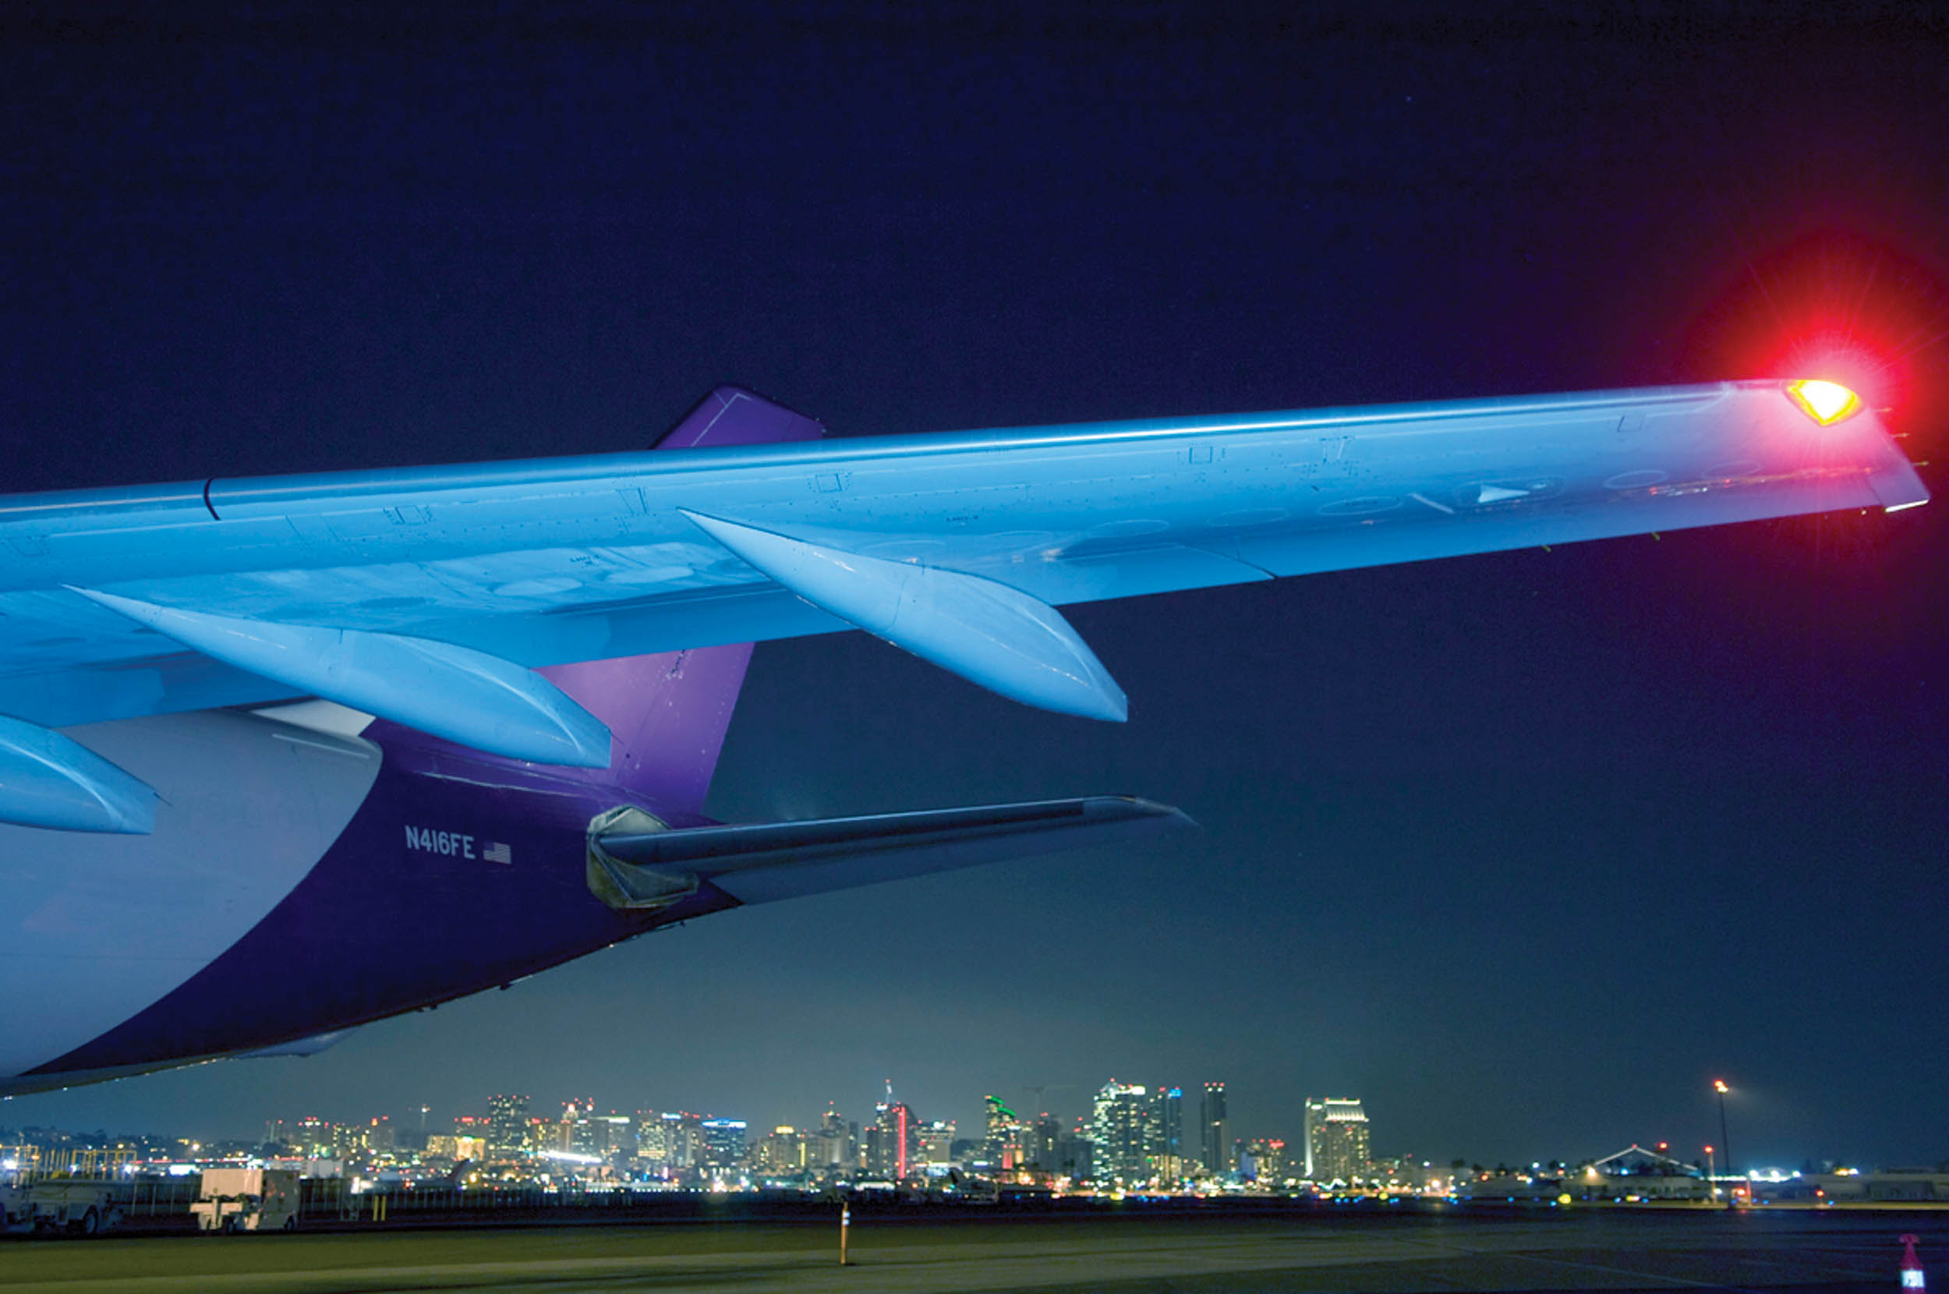
Definition: Missed Approaches
Commonly referred to as a “Go-Around,” a missed approach occurs when an aircraft cannot complete its landing and is required to make another attempt. It can be caused by:
Inclement weather conditions
Debris on the runway
ATC separation of aircraft, slower aircraft unable to exit airspace or runway, forcing larger aircraft to go around
Missed approaches are safety operations that the Authority cannot influence.

Slide 7
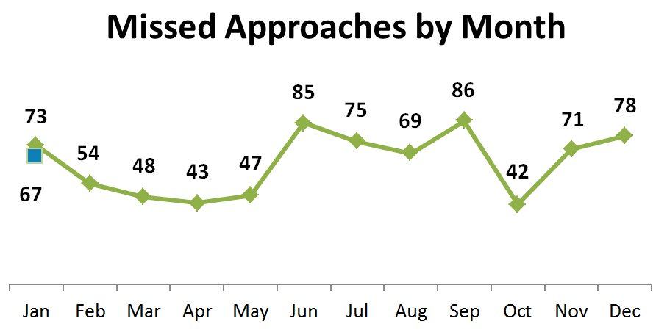

Missed Approach Statistics
YEAR | Total Missed Approaches | Total Arrivals | Total Arrivals that are Missed Approaches
2012 | 692 | 93,126 | 0.7%
2013 | 659 | 93,985 | 0.7%
2014 | 637 | 95,881 | 0.7%
2015 | 748 | 96,856 | 0.8%
2016 | 771 | 98,566 | 0.8%
2017 | 67* | 8,200* | 0.8%
*Through January 31, 2017

Slide 8
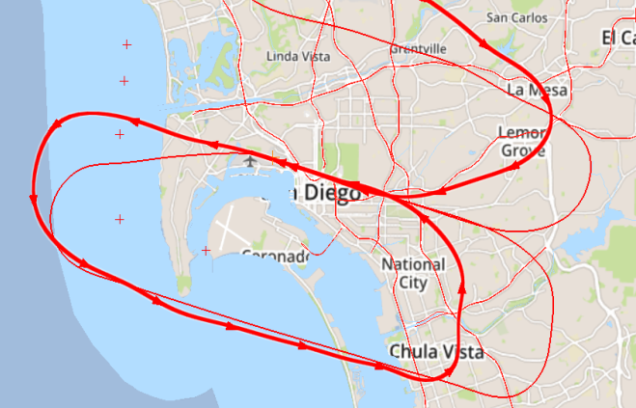
Missed Approach Noise Dot Compliance
Missed Approaches
Non-Compliant with FAA Noise Dots
Examples
Compliant
 | 2016 | 2017
Jan | 18 | 15*
Feb | 11
Mar | 10
Apr | 11
May | 12
Jun | 29
Jul | 25
Aug | 19
Sep | 22
Oct | 11
Nov | 11
Dec | 12
Non-Compliant
Noise Dot Compliance | Compliant | Non-Compliant
December 2016 | 66 | 12
January 2017 | 52 | 15
*Through January 31, 2017

Slide 9
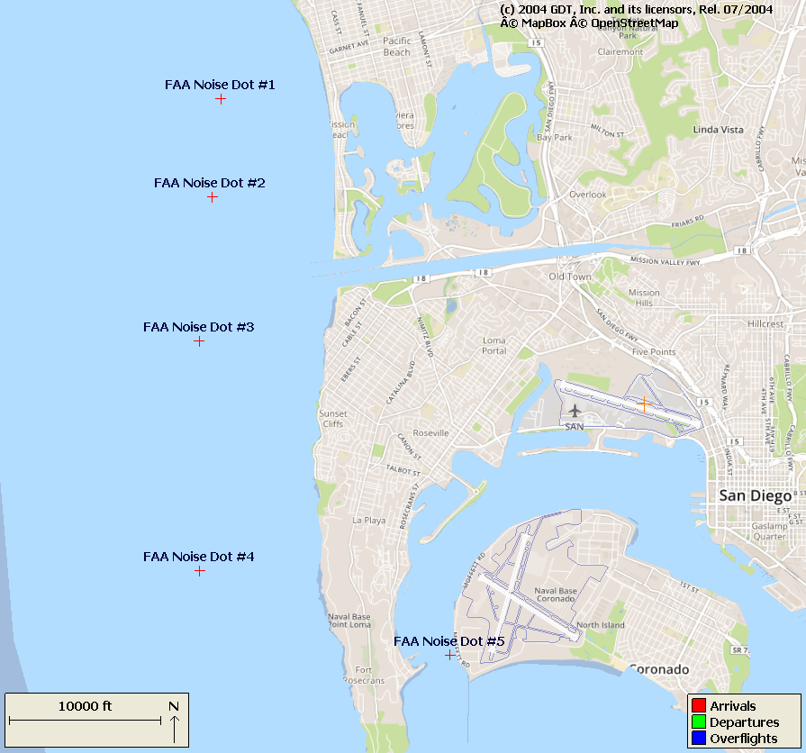
Definition: Early Turns
The Authority has defined early turns to the right as those aircraft that turn prior to FAA Noise Dot #1 at the 295-degree heading to the right.
Left early turns are defined as those aircraft that turn prior to the 265-degree heading to the left. Note: FAA has agreed to move Noise Dot #3 to the 265-degree heading this fall.
Causes for early turns can be similar to missed approaches and are often due to weather or separation.

Slide 10
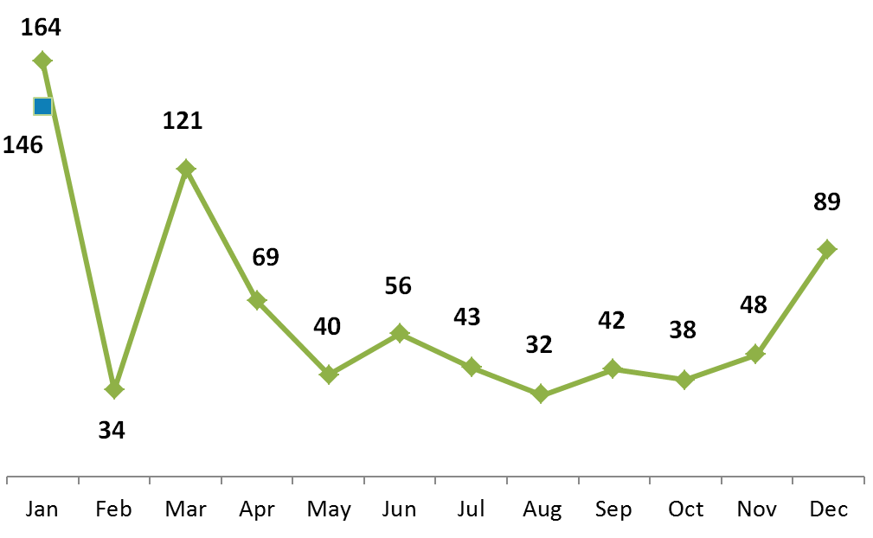
Early Turn Statistics
Early Turns By Month
YEAR | Right | Left | Below 6,000' | All Altitudes
2012 | 172 | 366 | 316 | 538
2013 | 110 | 719 | 200 | 829
2014 | 197 | 908 | 338 | 1,105
2015 | 330 | 963 | 467 | 1,293
2016 | 448 | 328 | 559 | 776
2017 | 112* | 34* | 131* | 146*
*Through January 31, 2017

Slide 11
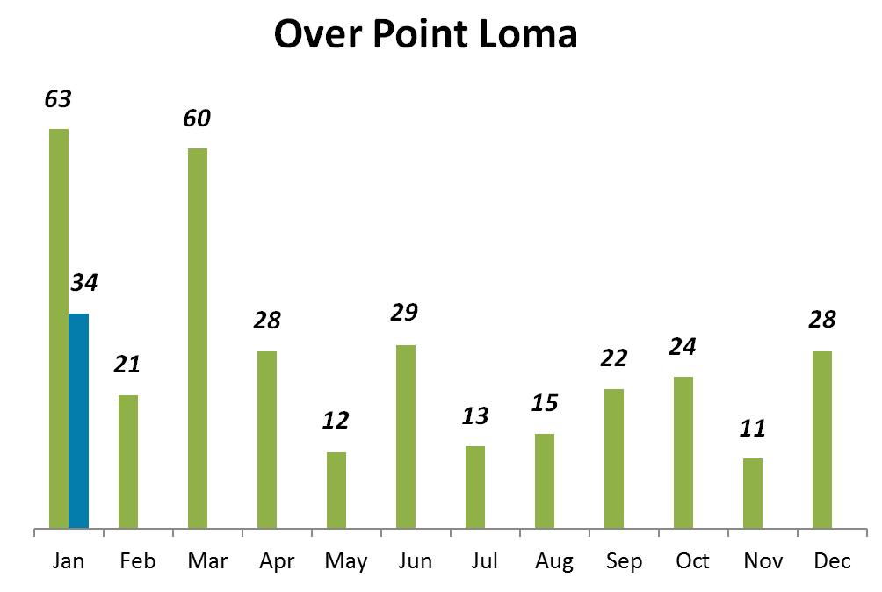
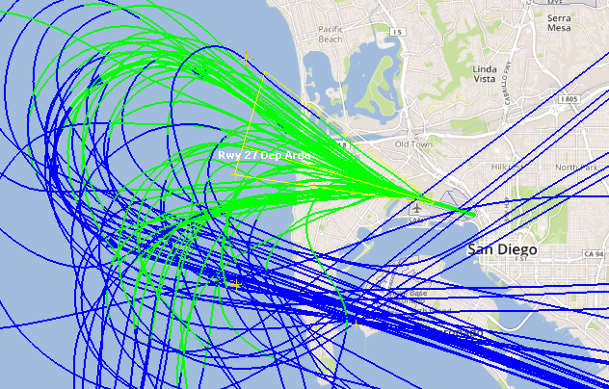
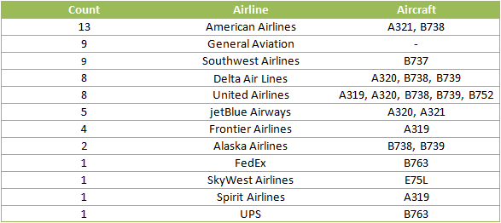
Early Turn Statistics - Left
December 2016 & January 2017
Decreased significantly over this time last year (34 vs. 63)

Slide 12
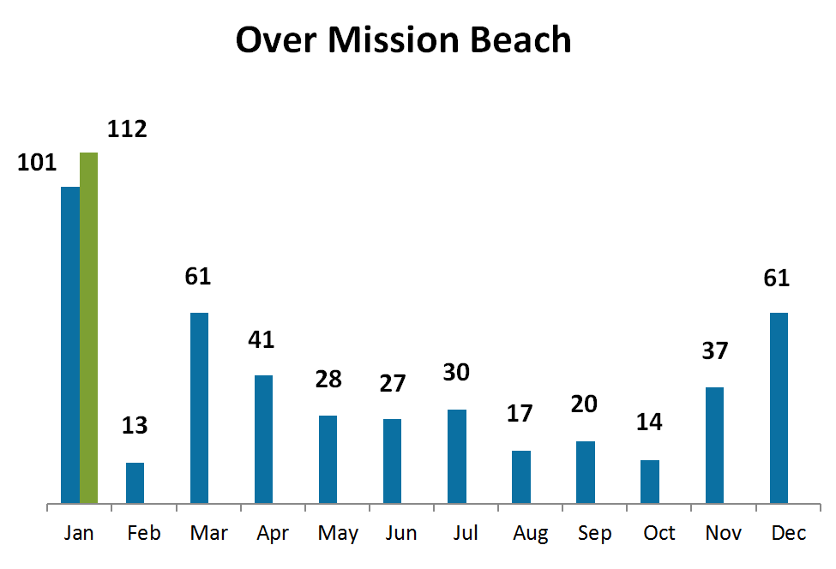
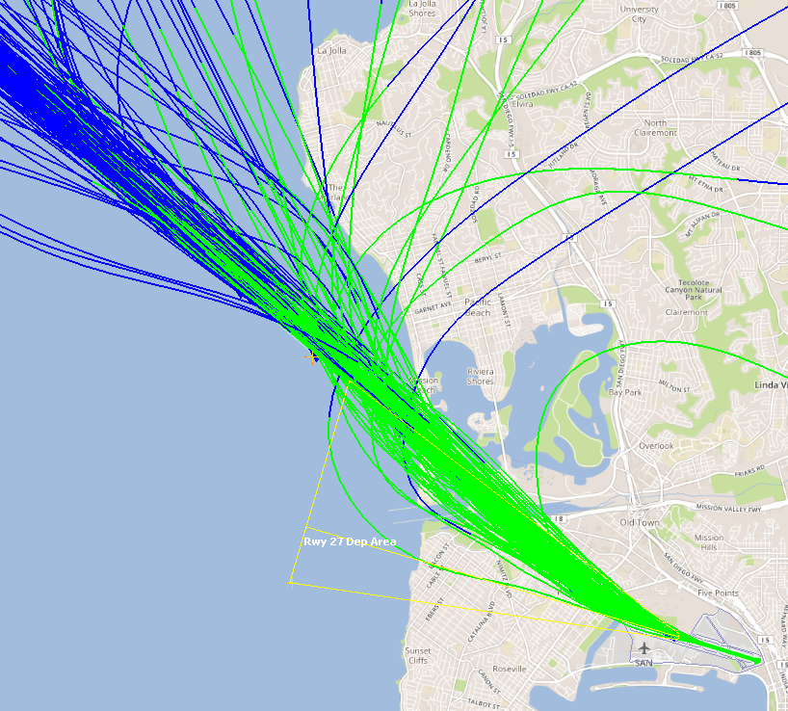
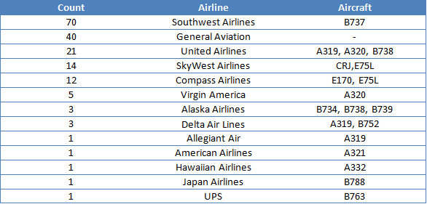
Early Turn Statistics - Right
December 2016 & January 2017
Tracking higher than last year (112 vs. 101)
Higher than previous two months (by 122)
*As of June 30, 2015

Slide 13
Noise Complaint Statistics
YEAR | Total Noise Complaints
2013 | 172
2014 | 156
2015 | 3,926
2016 | 31,624
2017 | 1,941*
1,941
*Through January 31, 2017

Slide 14
Top 5 Noise Events (most complaints)
Date | Event Time | Noise Event | Number of Complaints
1/4/2017 | 1:07 a.m. | Curfew Violation; jetBlue, late inbound aircraft, fined $20,000 | 11
1/24/2017 | 7:02 a.m. | Early Turn, instruction given by ATC due to weather | 8
1/24/2017 | 6:58 a.m. | Early Turn, instruction given by ATC due to weather | 7
12/28/16 | 10:23 p.m. | Early Turn, ATC called to report the aircraft turned early, pilot heard the wrong instructions | 6
1/24/17 | 7:12 a.m. | Early Turn, instruction given by ATC due to weather | 6
1/24/17 | 7:18 a.m. | Early Turn, instruction given by ATC due to weather | 6

Slide 15
Noise Complaint Breakdown
Reason for Complaint | Number of Complaints
Curfew Violation | 97
Missed Approach | 9
Heard at my Home | 1,502
Loud over Ocean | 146
Low or Loud | 696
Suspected Off-Course | 132
Suspected Off-Course and (Low and/or Loud) | 625
Other | 173
Grand Total | 3,380
Notes:
Other is correction, duplicate, fuel dumping, military, prop plane, helicopter, Montgomery field, no complaint described, questions.
94% of curfew violations are from Loma Portal
100% of loud over ocean is Bird Rock

Slide 16
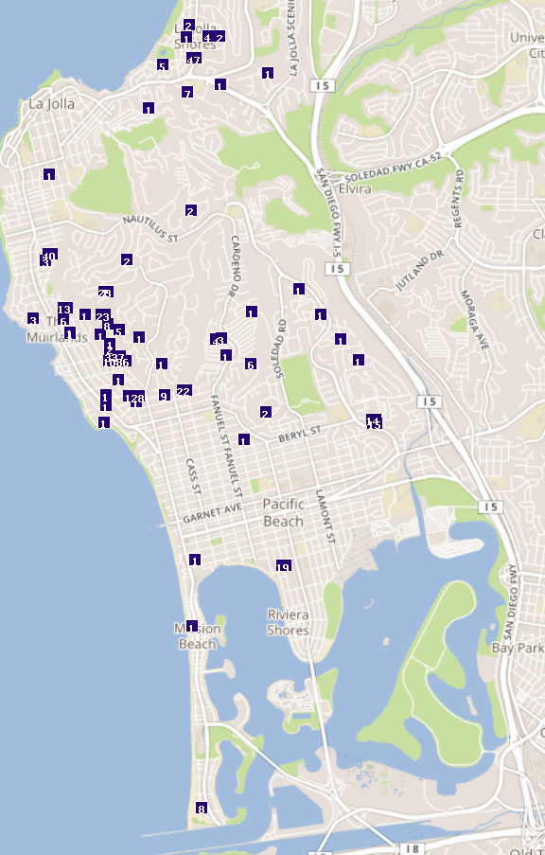
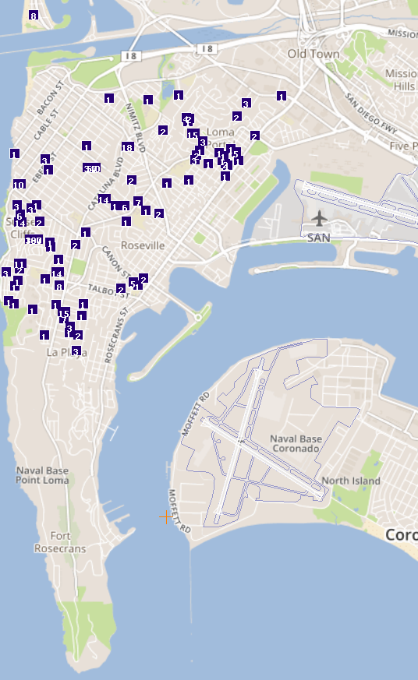
Noise Complaint by Neighborhood
La Jolla Shores
Neighborhood | Number of Complaints
Bird Rock | 1566
Sunset Cliffs | 649
Point Loma Heights | 452
La Jolla | 193
La Jolla Mesa | 85
College Area | 81
La Jolla Shores | 72
Loma Portal | 69
Pacific Beach | 55
Wooded Area | 48
Fleetridge | 21
Lemon Grove | 21
Ocean Beach | 18
Mission Beach | 9
South Park | 8
North Park | 6
Other(<5 complaints) | 27
Grand Total | 3380
Ocean Beach
Loma Portal
La Jolla
Point Loma Heights
Liberty Station
Sunset Cliffs
Fleetridge
La Jolla Mesa
Bird Rock
La Playa
Pacific Beach
Wooded Area
Mission Beach
32% or 1,086 of the noise complaints came from one (1) household.
La Jolla Area
Point Loma Area

Slide 17
Revised Subcommittee Workplan
Meeting Date: | Topic: | Tentative Presenters
November 16, 2016 | -FAA and Airline procedures for weather, safety and separation. -Accuracy of flight track data (FAA, ANOMS and WebTrak) | -FAA -B&K (WebTrak Vendor)
January 18, 2017 | -Assessment of historical vs. current arrival and depart procedures. Including FAA data overlay showing frequency and location over several years at specific locations (Bay Park, La Jolla Cove, Mt. Soledad, Mt. Helix, Sunset Cliffs, Wooded Area, Fleetridge, La Playa, and Mission Beach) | -FAA
March 15, 2017 | -Assessment of historical (years 2009, 2014 and 2016) vs. current arrival and depart procedures (of communities to range from Point Loma to La Jolla Shores) | -FAA
May 17, 2017 | -Review potential for procedure modifications to limit or prevent early turns and missed approaches. -Review of FAA noise dots and applicability. | -FAA -TERPS (Procedure Development) Expert
July 19, 2017 | -Curfew violation review process, including fine structure, policies for issuing fines, use of revenues in the community. -Quieter Home Program overview of eligibility, and changes in the regulations. -Noise monitors, location, costs, and results from portable monitoring. | -Airport staff, including Legal Counsel ---Acoustical consultant dealing with noise contours and sound insulation programs
September 20, 2017 | -Collect recommendations to make to ANAC

