Slide 1
Airport Noise Advisory Committee
October 19, 2016

Slide 2
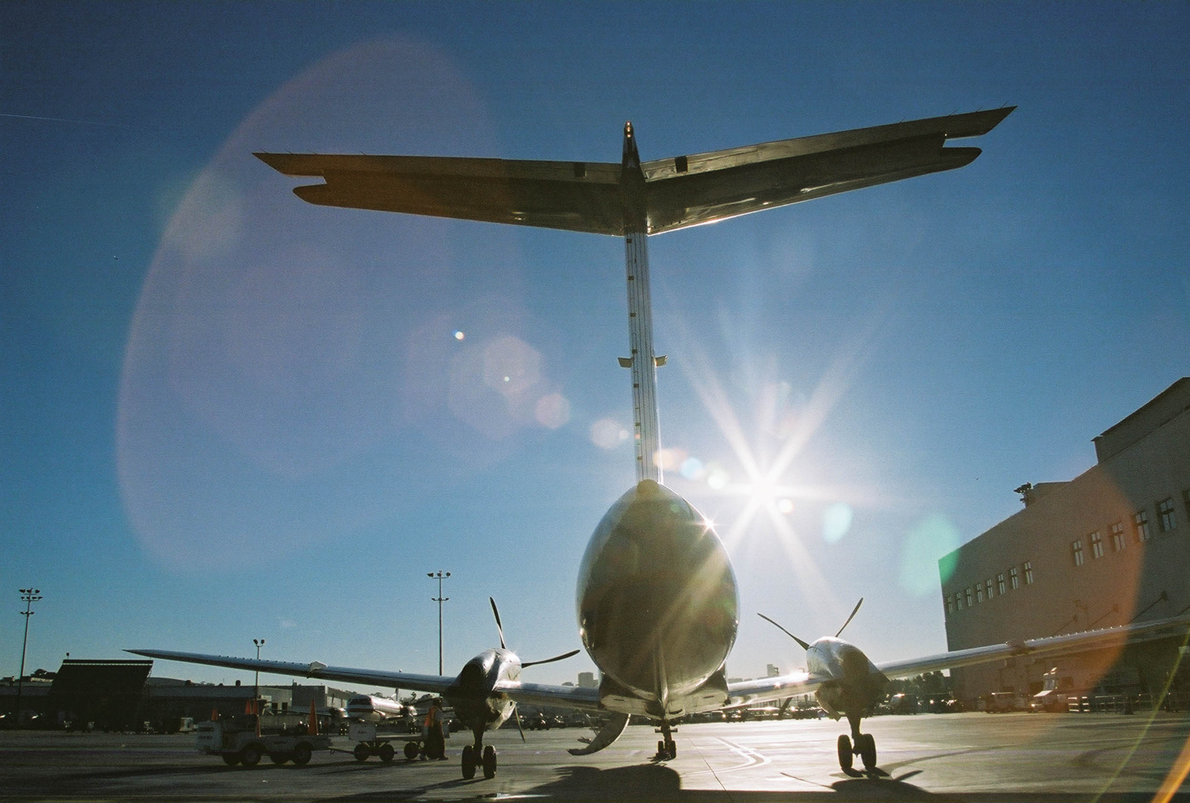
Agenda
Welcome and Introductions
Presentation Items
  Quieter Home Program Update
  Curfew Violation Review Panel
  Missed Approach
  Early Turn Statistics
  Noise Complaint Statistics
  Metroplex Update
Public Comment
Approval of August 17, 2016 Minutes
Information Items
  Airport Authority Update
New Business
    ANAC Subcommittee Update – Approval of Subcommittee Work Plan
Next Meeting: December 21, 2016
Adjourn
Notes:
Next meeting?

Slide 3
Quieter Home Program Update
PROGRAM STATISTICS
Applicants / Homes on the Wait List | 662/1,418
Homes Completed in August & September 2016 | 9
Estimated Homes to Complete in CY 2016 | 136
Total Completed Homes (through September 30, 2016) | 3,453
Updates
Continuing coordination with the FAA on revising construction contract documents.
Updating construction groups to place similar units in bid packages.

Slide 4
Curfew Violation Review
Curfew Violations for August - September, 2016
Date | Time | RWY | Operator / Flight ID | Aircraft | Amount Fined
8/1/2016 | 0144 | 27 | British Airways Flt 72A | Boeing 747-436 (B744) | $30,000
8/6/2016 | 2330 | 27 | Air Canada Rouge Flt 1884 | Airbus A319-114 (A319) | $20,000
8/6/2016 | 0007 | 27 | Air Canada Rouge Flt 1884 | Airbus A319-114 (A319) | $20,000
8/6/2016 | 2342 | 27 | jetBlue Airways Flt 530 | Airbus A320-232 (A320) | $0
8/12/2016 | 0038 | 27 | jetBlue Airways Flt 530 | Airbus A320-232 (A320) | $12,000
8/14/2016 | 2358 | 27 | Air Canada Rouge Flt 1884 | Airbus A319-114 (A319) | $0
8/23/2016 | 0024 | 27 | British Airways Flt 72A | Boeing 747-436 (B744) | $30,000

Slide 5
Curfew Violation Review (cont.)
Curfew Violations for August - September, 2016 (cont.)
Date | Time | RWY | Operator / Flight ID | Aircraft | Amount Fined
8/28/2016 | 2330 | 27 | Compass Airlines Flt 6033 | Embraer (ERJ 175) | $2,000
8/29/2016 | 0007 | 27 | American Airlines Flt 1362 | Boeing 737-823 (B738) | $4,000
8/31/2016 | 2330 | 27 | Pegasus Elite Aviation Flt N962SS | Gulfstream IV (G-IV) | $6,000
8/31/2016 | 2353 | 27 | Air Canada Rouge Flt 1884 | Airbus A319-114 (A319) | $0
9/2/2016 | 0021 | 27 | Air Canada Rouge Flt 1884 | Airbus A319-114 (A319) | $20,000
9/6/2016 | 0211 | 27 | British Airways Flt 72A | Boeing 747-436 (B744) | $30,000
9/10/2016 | 2344 | 27 | Air Canada Rouge 1884 | Airbus A319-113 (A319) | Pot. $20,000
9/15/2016 | 0138 | 27 | British Airways 72A | Boeing 747-436 (B744) | Pot. $30,000

Slide 6
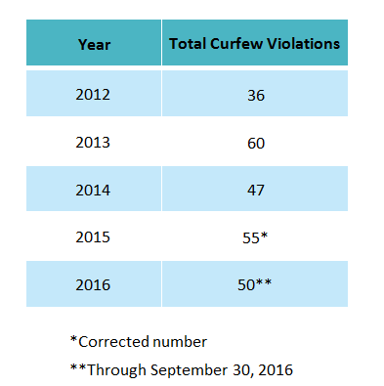
Curfew Violation Review Panel Stats

Slide 7
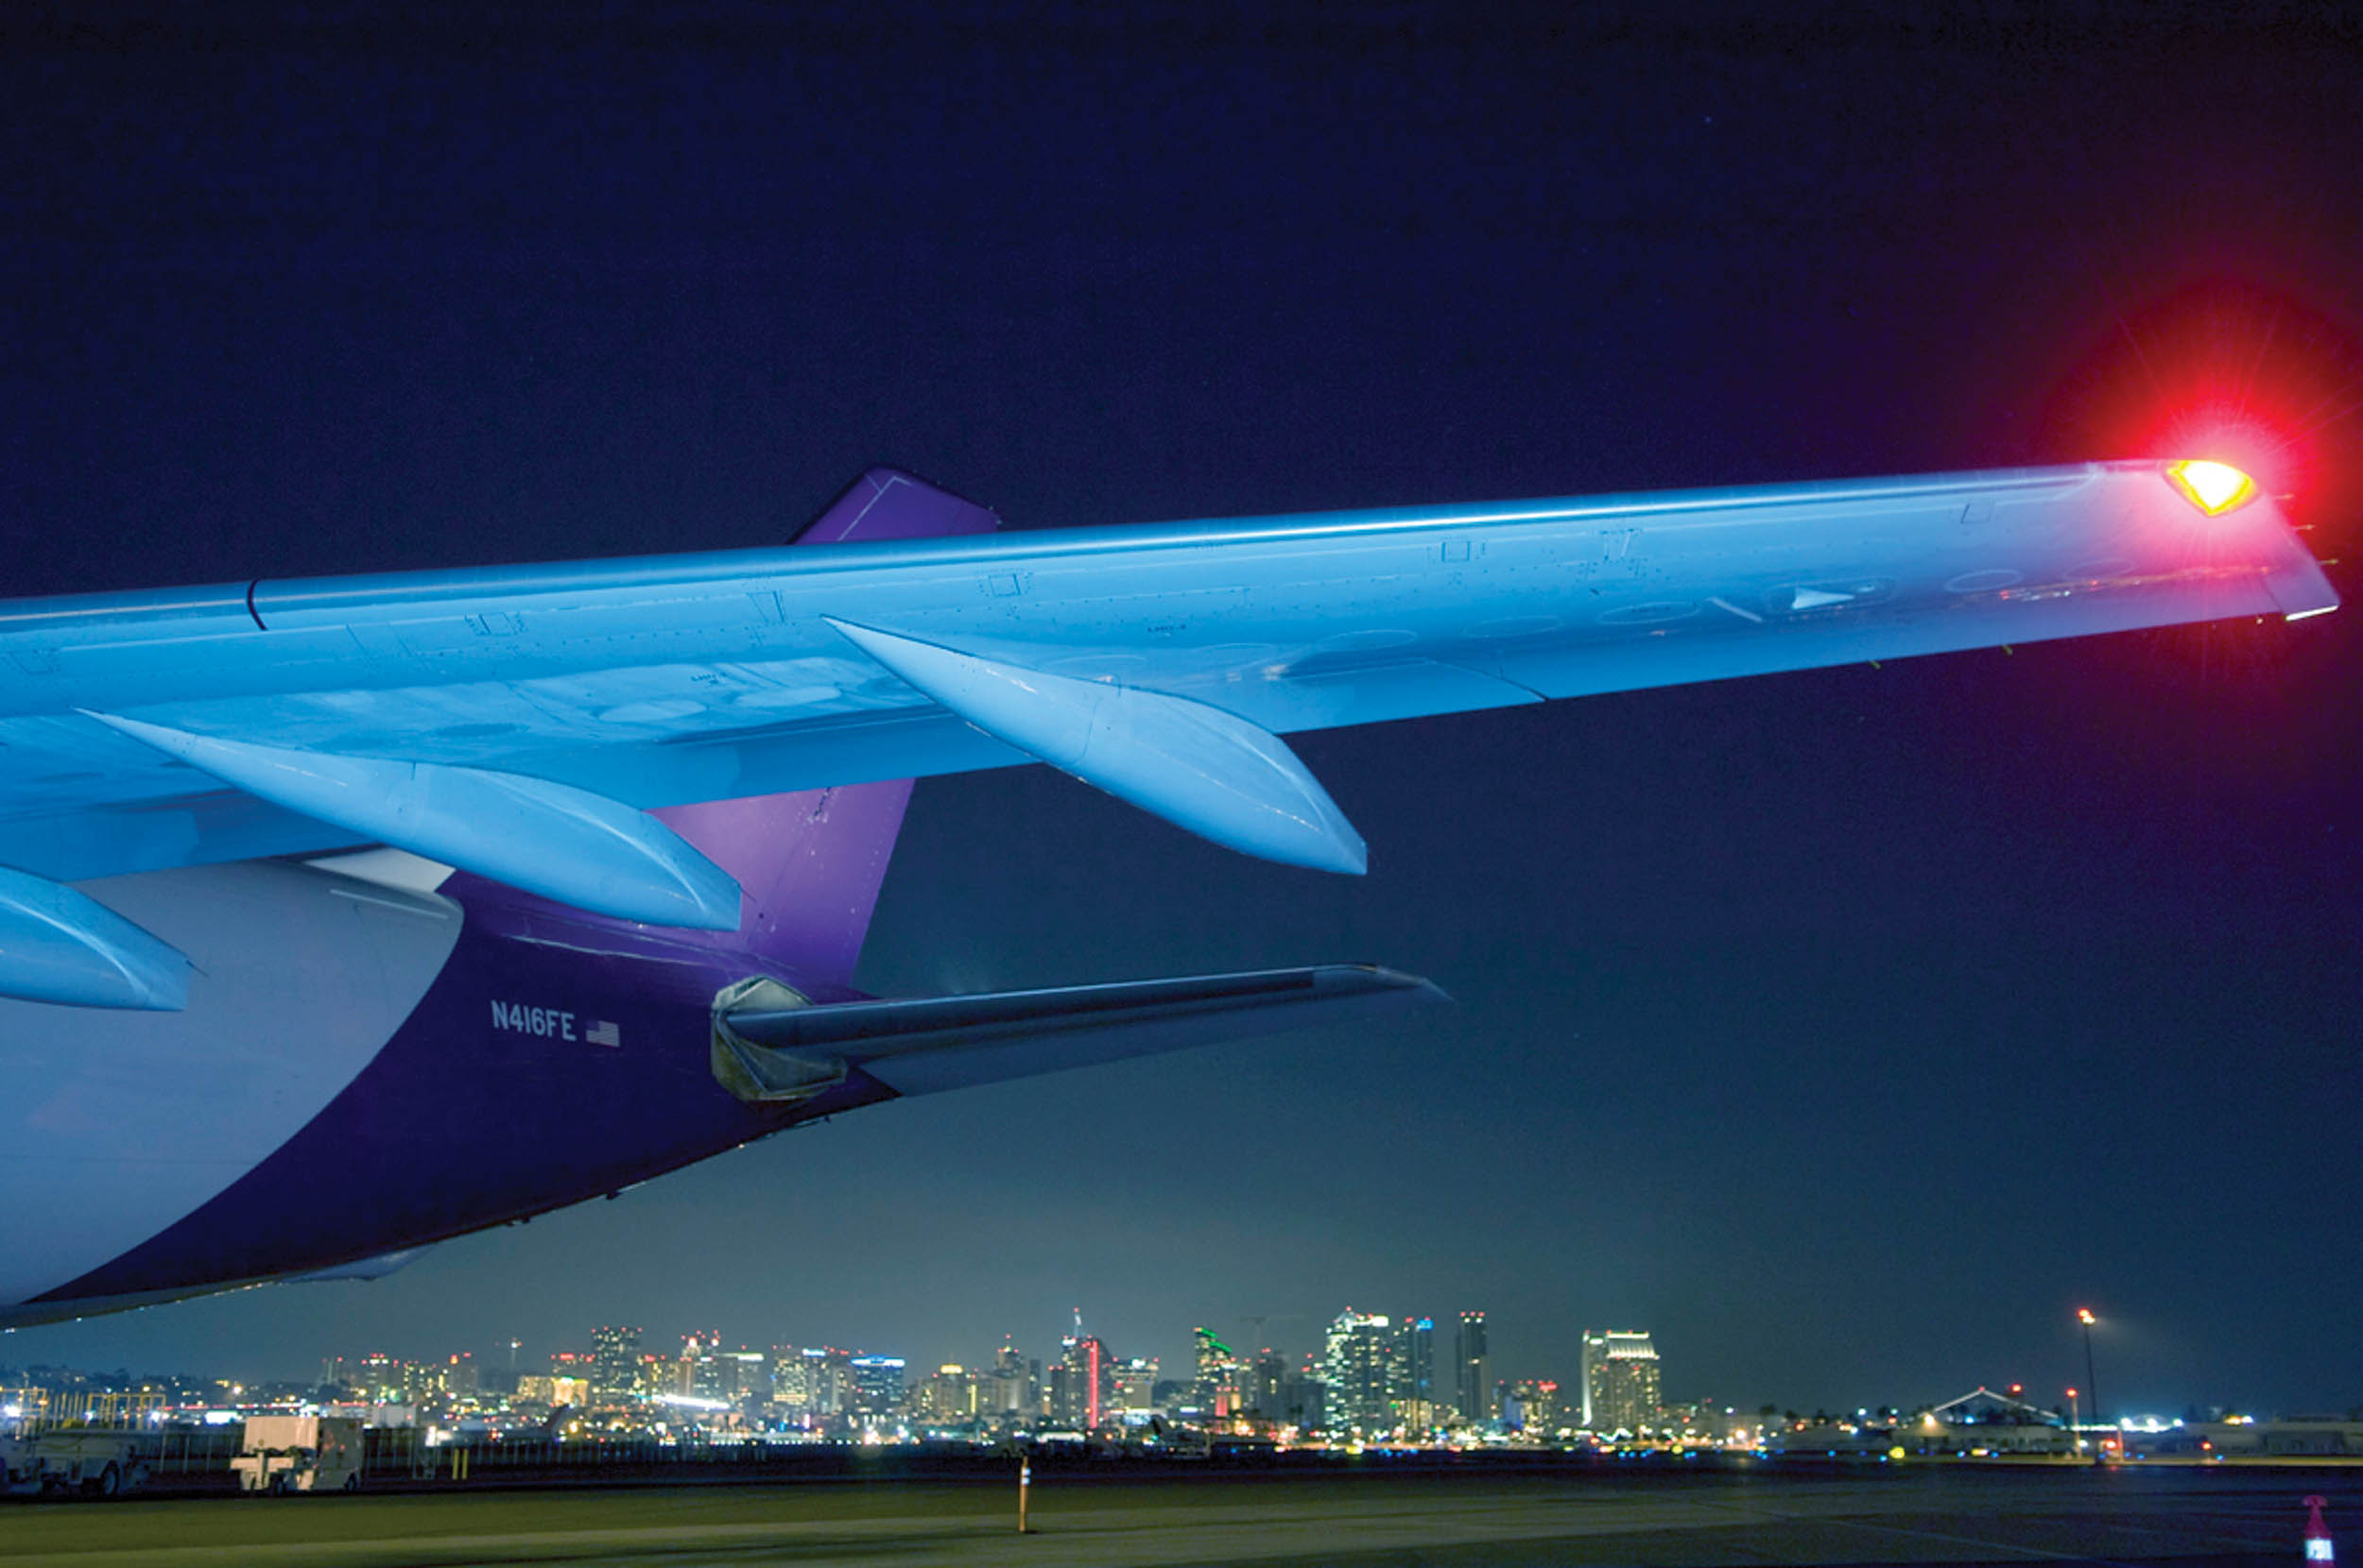
Definition: Missed Approaches
Commonly referred to as a “Go-Around,” a missed approach occurs when an aircraft cannot complete its landing and is required to make another attempt. It can be caused by:
Inclement weather conditions
Debris on the runway
ATC separation of aircraft, slower aircraft unable to exit airspace or runway, forcing larger aircraft to go around
Missed approaches are safety operations that the Authority cannot influence.

Slide 8
Missed Approach Statistics
YEAR | Total Missed Approaches
2012 | 692
2013 | 659
2014 | 637
2015 | 748
2016* | 569*
*Through September 30, 2016
Of the 155 Missed Approaches in August & September, 112 were compliant with the FAA Noise Dots.
*As of June 30, 2015

Slide 9
Definition: Early Turns
The Authority has defined early turns to the right as those aircraft that turn prior to FAA Noise Dot #1 at the 295-degree heading to the right.
Left early turns are defined as those aircraft that turn prior to the 265-degree heading to the left. Note: FAA has agreed to move Noise Dot #3 to the 265-degree heading this fall.
Causes for early turns can be similar to missed approaches and are often due to weather or separation.

Slide 10
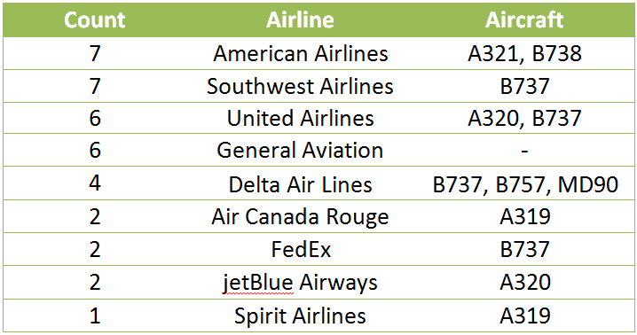
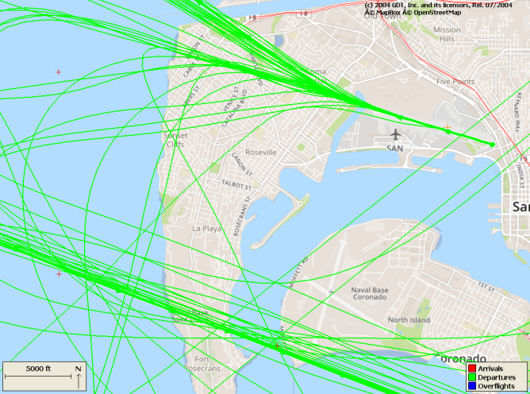
Early Turn Statistics - Left
Over Point Loma
August & September 2016
Early Turns to the LEFT
Increase over this time last year.
Overall, less than one early turn per day.
Less than the previous 2 months.
*As of June 30, 2015

Slide 11
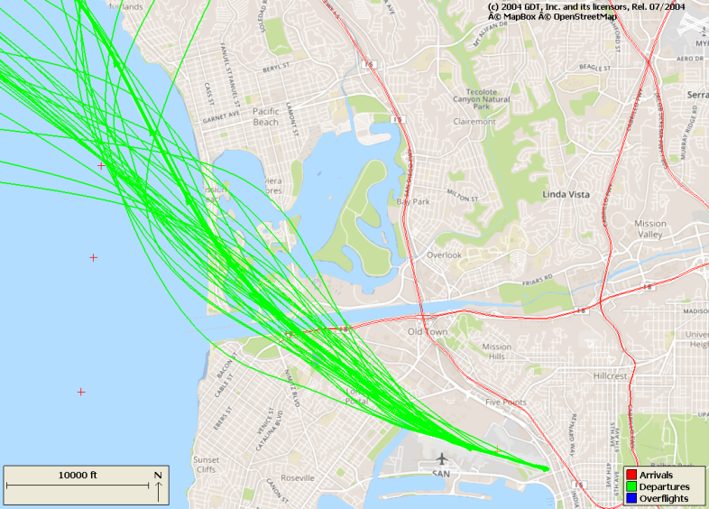
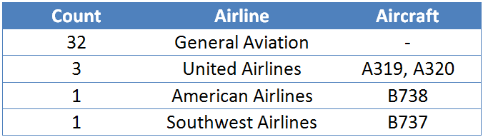
Early Turn Statistics - Right
Over Mission Beach
August & September 2016
Early Turns to the RIGHT
Tracking higher than last year.
Less than one early turn per day.
*As of June 30, 2015

Slide 12
Early Turn Statistics
YEAR | Total Early Turns
2012 | 175
2013 | 196
2014 | 260
2015 | 395
2016* | 443
2016 Early Turns by Month
From August 1 – September 30, 2016 there were
*Through September 30, 2016
16,905
0.4%
Departures to the west.
Were early turns.
*As of June 30, 2015

Slide 13
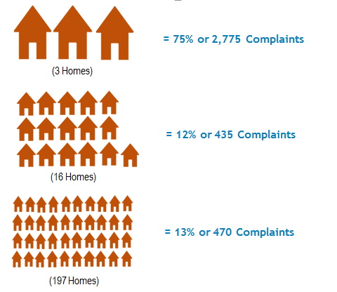
Noise Complaint Statistics
YEAR | Total Complaints
2012 | 232
2013 | 172
2014 | 156
2015 | 3,926
2016* | 28,676

Slide 14
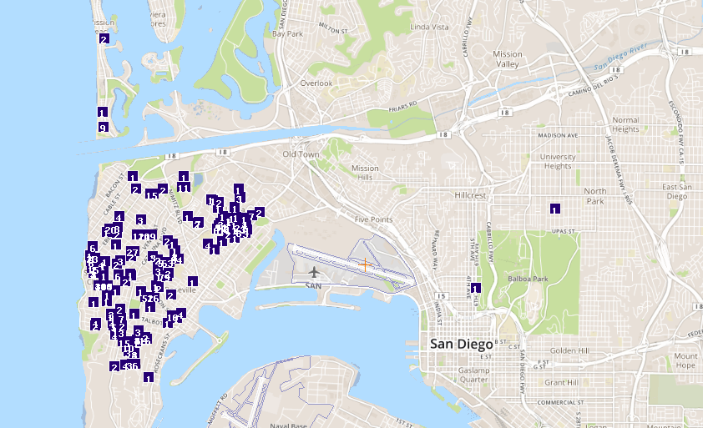
Noise Complaint Locations

Slide 15
ANAC Subcommittee Work Plan
Meeting Date: | Topic: | Tentative Presenters:
November 16, 2016 | FAA and Airline procedures for weather, safety and separation. Accuracy of flight track data (FAA, ANOMS and Webtrak) | FAA B&K (WebTrak Vendor)
January 18, 2017 | Assessment of historical vs. current arrival and depart procedures. Including FAA data overlay showing frequency and location over several years at specific locations (Bay Park, La Jolla Cove, Mt. Soledad, Mt. Helix, Sunset Cliffs, Wooded Area, Fleetridge, La Playa, and Mission Beach) | FAA
March 15, 2017 | Review potential for procedure modifications to limit or prevent early turns and missed approaches. Review of FAA noise dots and applicability. | FAA TERPS (Procedure Development) Expert
May 17, 2017 | Curfew violation review process, including fine structure, policies for issuing fines, use of revenues in the community. Quieter Home Program overview of eligibility, and changes in the regulations. Noise monitors, location, costs, and results from portable monitoring. | Airport staff, including Legal Counsel Acoustical consultant dealing with noise contours and sound insulation programs
TBD | TBD

