Slide 1
Airport Noise Advisory Committee
June 15, 2022

Slide 2
Agenda
  Welcome & Roll Call
  ZZOOO THREE Departure – Update By FAA
  Part 150 / EIR Noise Mitigation Measure Updates
  Current Aircraft Noise Trends
  Update on Pilot Program: Portable Noise Monitoring
  Approval of Meeting Summary from March 16, 2022
  Adjourn – Next Meeting September 21, 2022

Slide 3
ZZOOO3 Departure (ANAC’s Requested Flight Path Change)
Joe Bert,
Federal Aviation Administration
Notes:
Where did Background go?

Slide 4
ZZOOO THREE Departure Procedure
Airport Noise Advisory Committee (ANAC) Briefing, June 15, 2022

Slide 5
Overview
The purpose of the proposed amendment is to provide noise relief to some San Diego area communities by moving JETTI waypoint (WP)—and the corresponding southbound leg to ZZOOO WP—farther away from the shoreline.
JETTI WP would move approximately two nautical miles (NM) west-northwest of its current location.
The publication date is currently scheduled for 07/14/2022.

Slide 6
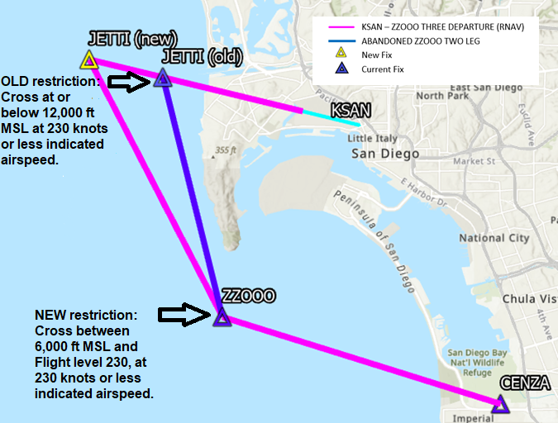
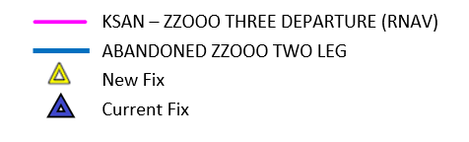
ZZOOO Departure Procedure
ZZOOO TWO has a restriction to cross current JETTI WP at or below 12,000 ft MSL at 230 knots or less indicated airspeed. The altitude restriction would be removed.
ZZOOO THREE would delete the altitude restriction at JETTI WP, and place a new restriction at ZZOOO WP of between 6,000 ft MSL and flight level 230. The speed restriction of 230 knots indicated airspeed would be continued out to ZZOOO WP.

Slide 7
Questions

Slide 8
Public Comment ZZOOO THREE Departure Update
Please remember to wait to call into the meeting until the Facilitator introduces the item that you would like to comment on.
To provide your public comment on this item:
  Dial 1-669-900-9128
  When prompted, input Conference ID: 816 2714 7250#
  You will be let into the meeting and will be unmuted
  Turn off YouTube to avoid feedback
  Before speaking, state your name and begin your comments
Notes:
Validate updated Conf. ID

Slide 9
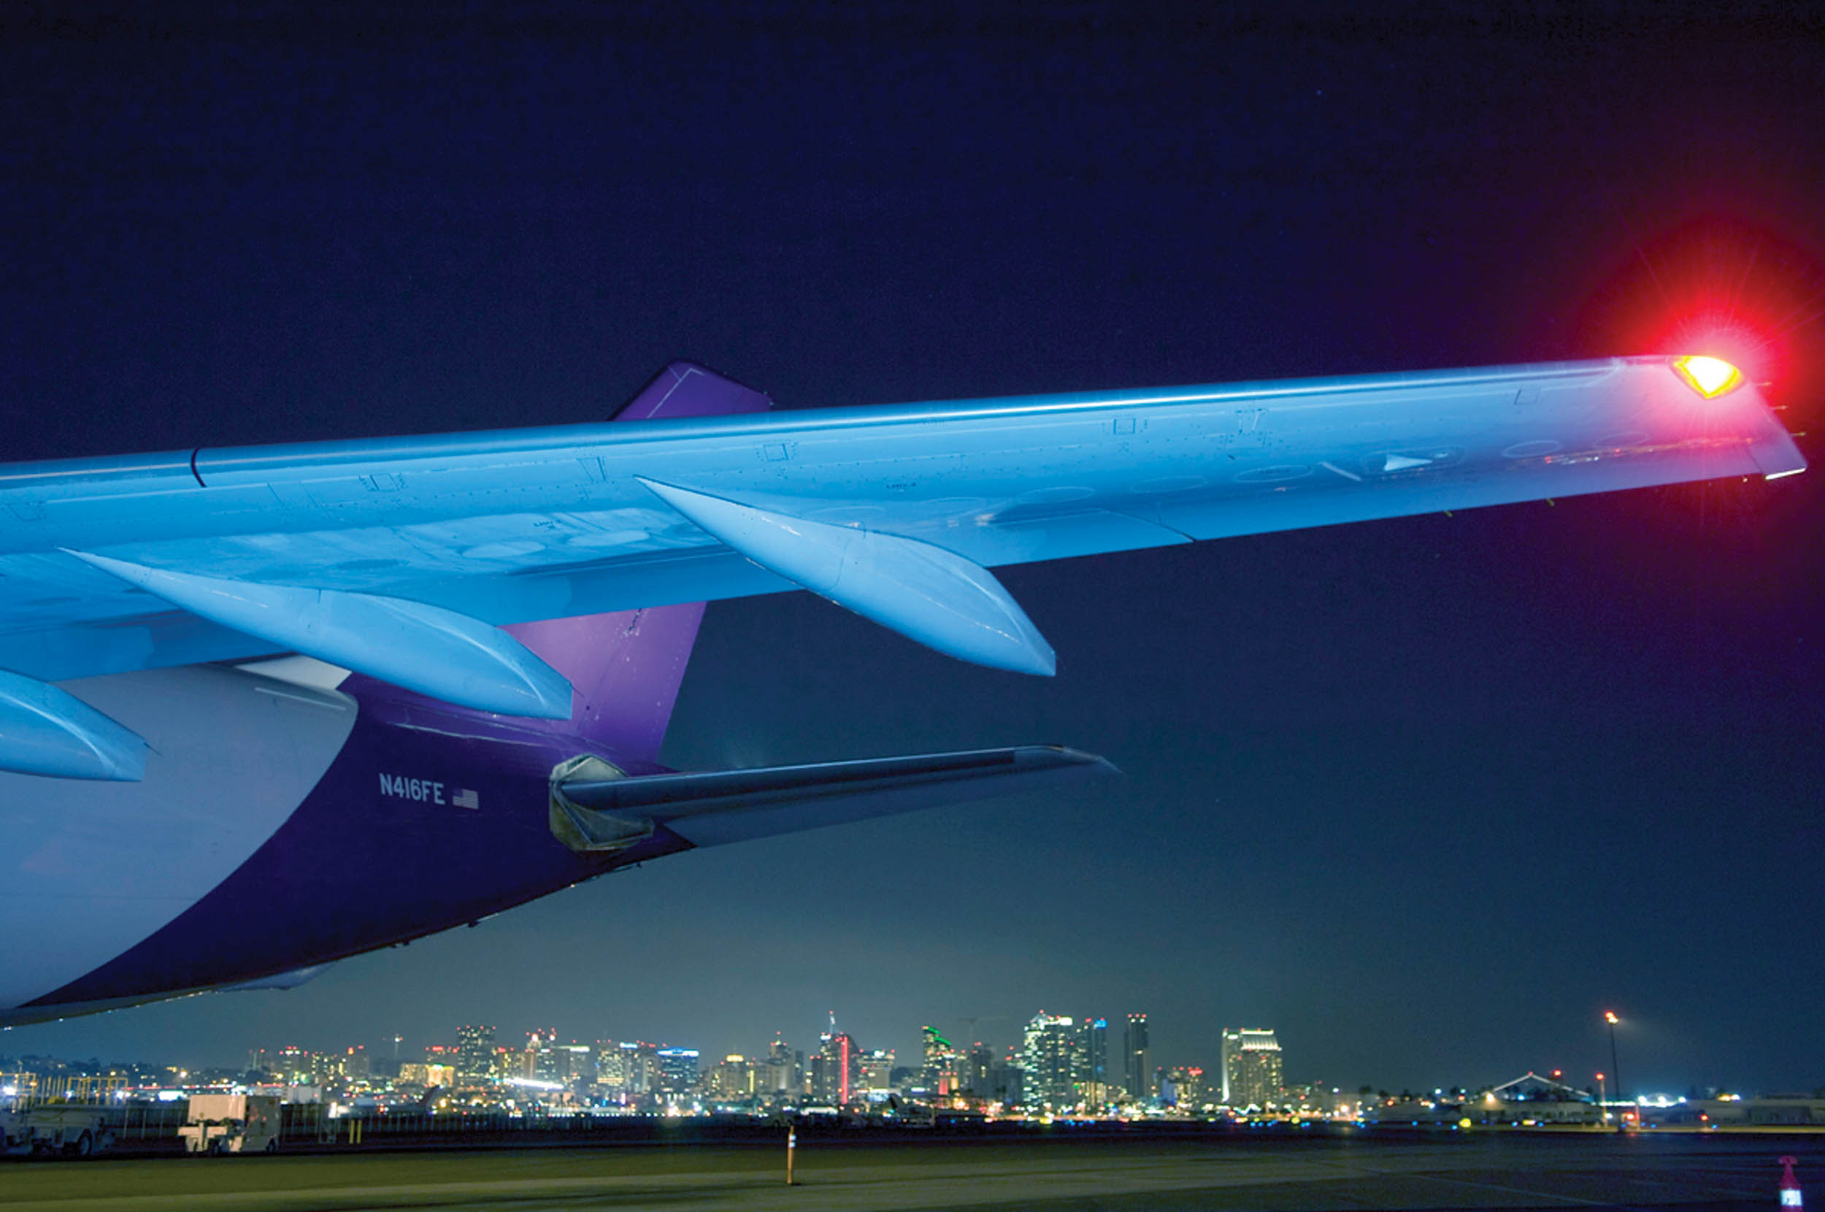
Questions ?

Slide 10
Update on Part 150 and EIR Noise Mitigation Measures
Sjohnna Knack
Program Manager

Slide 11
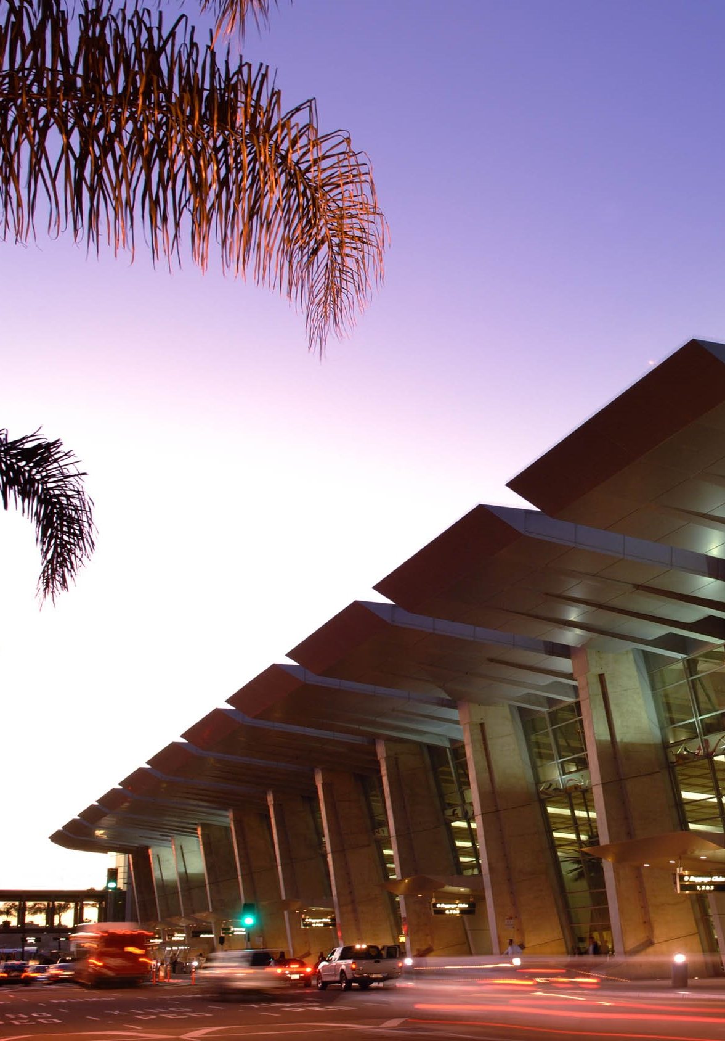
Part 150 Update
FAA provided additional comments and corrections in March, Airport Authority returned them in May.
FAA acknowledged receipt of Noise Exposure Map and will respond in 90 days (August).
Anticipated that the 180-day review period would start pending Noise Exposure Map Acceptance.
Staff has engaged a consultant to assist with the Noise Abatement Departure Procedure and is working with airlines and FAA.
Notes:
Change Image

Slide 12
New T1 Noise Mitigation Measures
Expansion of Sound Insulation
Update Noise Exposure Maps
Portable Noise Monitoring Program
Assess Findings of 2018 FAA Reauthorization (Noise)
Use Curfew Fines for Quieter Home Program
$26M in FAA grant funding, allows for increased number of homes and expand to include non-residential.
209 units in 2021 with 400 in 2022. Construction on one church/preschool.
Airport Authority will update contours every five years.
May 2022 resubmittal, anticipate updating in 2026.
Portable program has started with Pilot Program.
If FAA approves Part 150 recommendation, program can be expanded.
No current changes that would impact San Diego International Airport.
Possible within one year that noise & health research could be released.
2020, $16K used in 2021 for QHP. 2021, $204K will be used in 2022 for QHP.
Notes:
10. Conduct Portable Noise Monitoring – Two sites (Point Loma and Mission Beach) were monitored for two weeks to help validate the modeled noise. A portable noise monitoring program is a recommendation in the Part 150 update.
11. Review Feasibility of Noise Barriers – Analyzed in the Part 150 update and determined they did not reduce the noise impacts to non-sensitive uses. Not recommended.
14. & 15. Flight Procedure Suggestions to Reduce Noise- Departure to the Northwest (PADRZ) & East (ZZOOO) – ANAC recommendations (and other variations of those recommendations) were reviewed for feasibility, most showed a shift in noise over new, non-compatible uses. Only the two nighttime RNAV departures (one for East route and one for Northwest Route) were recommended (ANAC Approved on May 5, 2021) and they was submitted to FAA via IFP Gateway on May 26, 2021.
17. Increase Compliance on Nighttime Noise Abatement Procedures – Analysis in the Part 150 showed that any modification to the Nighttime Noise Abatement Procedures would shift noise over new, non-compatible land uses. It is anticipated with the recommendation of the Nighttime RNAV departures, early turns may decrease.
21. Noise Abatement Departure Procedure (NADP) – Analysis in the Part 150 showed some noise reduction with the use of an NADP, and it was a recommendation in the Part 150 update. Staff is already working with air carrier operators to discuss implementation.

Slide 13
Public Comment on Part 150 Update & EIR Noise Mitigation Measures is Now Open
Please remember to wait to call into the meeting until the Facilitator introduces the item that you would like to comment on.
To provide your public comment on this item:
  Dial 1-669-900-9128
  When prompted, input Conference ID: 816 2714 7250#
  You will be let into the meeting and will be unmuted
  Turn off YouTube to avoid feedback
  Before speaking, state your name and begin your comments

Slide 14
Questions ?

Slide 15
Current Aircraft Noise Trends
William Hobson, Aircraft Noise Specialist

Slide 16
Current Aircraft Noise Trends
Curfew Violations continue to trend up, based on increased operations and no construction closures. Working with air carriers like Alaska and jetBlue to reschedule late night departures.
Early Turns remained the same at around 0.3% of total departures, with more flights, FAA is keeping most aircraft on the published routes (updated data).
Missed Approaches are trending down.
Noise Complaints have increased by 13% from last year.
View our website for monthly updates on these statistics and call our office with any questions!
Notes:
Add some images to break up text.
Billy to review trends in noise complaints from March – May 2021 versus March May 2022. # of households? # of complaints? Locations? Types of complaints?

Slide 17

Activity Trends
Fleet
Domestic widebody use is down. Replaced with narrowbody aircraft
New Air Service
New/Recovered service to markets in Oakland, Vancouver, Montreal, Toronto
Operations
Operations are at 82% of pre-COVID levels
Passengers
Passengers are at 85% of pre-COVID levels

Slide 18
Public Comment on Current Noise Concerns & Trends
Please remember to wait to call into the meeting until the Facilitator introduces the item that you would like to comment on.
To provide your public comment on this item:
  Dial 1-669-900-9128
  When prompted, input Conference ID: 816 2714 7250#
  You will be let into the meeting and will be unmuted
  Turn off YouTube to avoid feedback
  Before speaking, state your name and begin your comments

Slide 19
Questions ?

Slide 20
Update on Pilot Program: Portable Noise Monitoring
Roman Lanyak,
Sr. Aircraft Noise Specialist

Slide 21
Pilot Portable Noise Monitoring Program
Process Overview
Application
Testing
Reporting
Expectations
  Need two ANAC members to volunteer, East and West
  Application reviews security of testing location
  Testing Agreement
  Setup during week
  Testing for around 14 days
  Must not have any other prominent noise sources (i.e., roadway, pets, etc.)
  Report will be available within 14 business days
  Includes metrics like Single Event Level (SEL) and Lmax
  Reports will be posted online (with general location info)
  Reports cannot be used to determine eligibility in QHP
Process is still in Pilot phase and not open for general public
Notes:
Send to Steve Smith for review, he ran a similar program in Chicago.
Review for accuracy, I think some points can be discussed.
Did anything critical get excluded?

Slide 22
Public Comment on Portable Monitoring is Now Open
Please remember to wait to call into the meeting until the Facilitator introduces the item that you would like to comment on.
To provide your public comment on this item:
  Dial 1-669-900-9128
  When prompted, input Conference ID: 816 2714 7250#
  You will be let into the meeting and will be unmuted
  Turn off YouTube to avoid feedback
  Before speaking, state your name and begin your comments

Slide 23
Questions ?

Slide 24
Public Comment on Non-Agenda Items
Please remember to wait to call into the meeting until the Facilitator introduces the item that you would like to comment on.
To provide your public comment on this item:
  Dial 1-669-900-9128
  When prompted, input Conference ID: 816 2714 7250#
  You will be let into the meeting and will be unmuted
  Turn off YouTube to avoid feedback
  Before speaking, state your name and begin your comments

Slide 25
Approval of March 16,2022
Meeting Summary

Slide 26
Public Comment on March 16, 2022, Meeting Summary
Please remember to wait to call into the meeting until the Facilitator introduces the item that you would like to comment on.
To provide your public comment on this item:
  Dial 1-669-900-9128
  When prompted, input Conference ID: 816 2714 7250#
  You will be let into the meeting and will be unmuted
  Turn off YouTube to avoid feedback
  Before speaking, state your name and begin your comments

Slide 27
Announcements & Adjourn
Next Meeting September 21, 2022

